Slide 1
Position Analysis with CalLite
Kevin, Messele, En-Ching, Erik, Nazrul

Slide 2
Position Analysis with CalLite
Past
Observed Data
Future
Simulated/Forecasted Data
JUN
JUL
AUG
SEP
Oct
Nov
Dec
Jan
Feb
Mar
Oct
Nov
Dec
Jan
Feb
Mar
Oct
Nov
Dec
Jan
Feb
Mar

Slide 3
Platform
WRIMS v2
CalLite
Vista Jython

Slide 4
Position Analysis with CalLite
Past Months
Observed Data
Future Months
Simulated/Forecasted Data

Slide 5
Position Analysis with CalLite
2013 WY
Simulated with Historical Data
2012 WY
Observed Data
Oct
Nov
Dec
Jan
Feb
Mar
JUN
JUL
AUG
SEP
1976
Oct
Nov
Dec
Jan
Feb
Mar
1977
Oct
Nov
Dec
Jan
Feb
Mar
1983

Slide 6
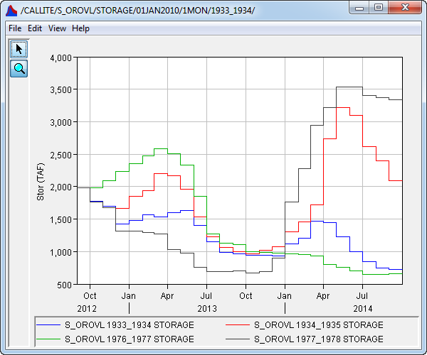
Result Example

Slide 7
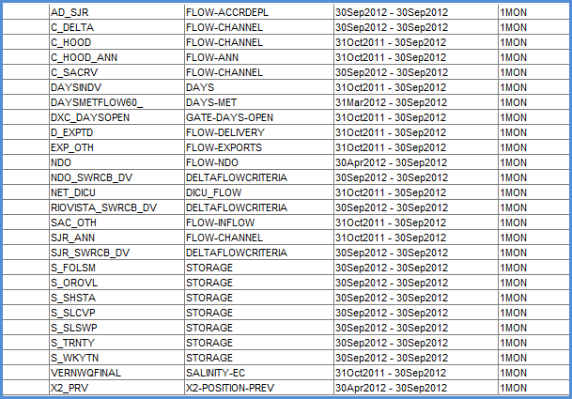
Step 1. Prepare initial data

Slide 8
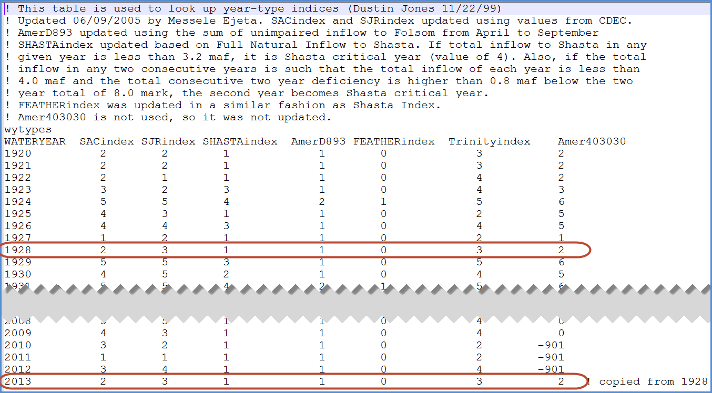
Step 2. Copy historical yearly tables to future

Slide 9
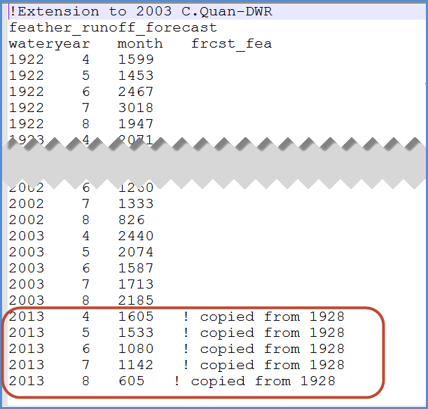
Step 3. Copy historical monthly tables to future

Slide 10
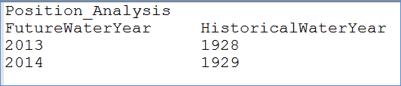
Step 4. Create lookup table to convert future WY to historical WY

Slide 11
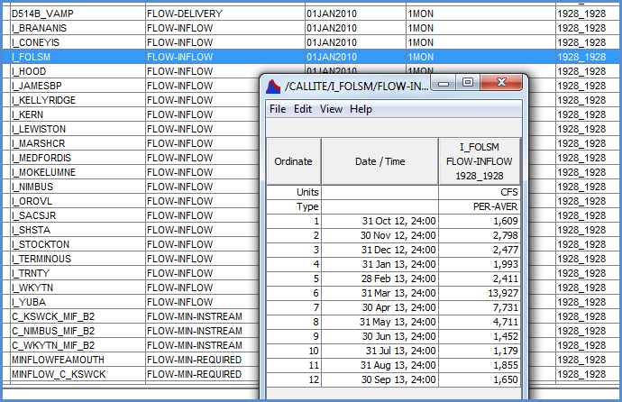
Step 5. Copy historical Svar data to future

Slide 12
Issues
Automatic water year type generation - for forecasted data or non-historical data
Encapsulate D1485 lookup table related code - so D1485 tables will not be necessary when D1485 option is off
ANN salinity with non-historical data
Start month is not October

Slide 14
Step 1. Provide initial data for decision variables. See .\Run\DSS\CL_INIT_2012.dss
Step 2. Provide 2012 annual requests data in this table: \Run\Lookup\PA_Base_D1641_Existing\AnnualReqDel_swp.table
Step 3. Enter data in the following "User Input" section
Step 4. Open a command prompt and type "vscript example_positionAnalysis.py"
Step 5. A batch file named "CalLitePA_demo.bat" will be generated. Double click this batch file to run the project.

Slide 15
Position Analysis with CalLite
Past Months
Observed Data
Future Months
Simulated/Forecasted Data

Slide 16
Folsom lake storage (FOL)
Shasta lake storage (SHA)

